Slide 1
Welcome

Slide 2

Your Presenter
Tiffanie A. DeVan
Higher Education Access Partner
PA Higher Education Assistance Agency (PHEAA)
717-884-2200
tiffanie.devan@pheaa.org
Counties: Dauphin, Juniata, Mifflin, Northumberland, Perry, Schuylkill, Snyder & Union

Slide 3

Financial Aid Basics
Financial Aid: funds to help students pay the cost of an education at college & career schools.
Keep in mind:
Eligibility criteria may apply in order to receive/maintain financial aid
  Criteria varies based on type/source of aid
  Important to understand the terms and conditions
Students should play an active role in the process
  Share goals & career plans
  Take advantage of college fairs & school visits (ask about cost and available aid)
  Ask for assistance, if necessary
Some students many not qualify for all forms of aid
Must apply to be considered

Slide 4

Financial Aid Basics
Cost of Attendance(COA):
Costs that the student can expect to incur during a specific academic school year
Direct costs: billed by the school
Indirect costs: not included in bill but may be incurred
Student Aid Index (SAI)
Used to determine eligibility for need-based aid.
Based on information received from the Free Application From Federal Student Aid (FAFSA)
School costs include:
  Tuition and fees
  Housing & Food
  Books and supplies
  Transportation
  Miscellaneous living expenses
  Childcare, if necessary
Financial Need = COA – SAI
Schools will determine need after reviewing financial aid applications
Schools determine aid based on need, eligibility & available funding at their schools

Slide 5



Types of Financial Aid
    Grants: Free Money (based on financial need)
    Scholarships: Free Money (based on merit/select criteria or need)
    Work Study: Earned Income
    Student Loans: Borrowed money that must be repaid

Slide 6
Sources of Aid
Federal Government (studentaid.gov)
State Government (pheaa.org)
School or College
Scholarships

Slide 7
Scholarships
There is something for everyone!
Appily.com
BigFuture.Collegeboard.org
Chegg.com
CollegeAnswer.com
CollegeNet.com
DoSomething.org/Scholarships
FastWeb.com
Goingmerry.com
Hbcuconnect.com
Internationalscholarships.com
www.iefa.org
thepasshefoundation.com
Raise.me
Www.sacfoundation.com
ScholarshipExperts.com
Www.sacfoundation.com
Tfec.org
Uncf.org
Unigo.com
Scholarships come in all shapes, sizes & forms
Athletics
E-sports
Music – chorus, band
Community and Volunteer Service
Ethnicity
Special Interests -hobbies, club membership (Elks, Moose), church
Employment
Religion
Talent / Creativity

Slide 8
Scholarships
Postsecondary Scholarships
Local and Regional Scholarships
National Scholarships

Slide 9
Federal Student Aid Programs
MUST SUBMIT FAFSA®
Federal Program | Program Details | Annual Max Award *
Pell Grant | Awarded to undergraduate students who demonstrate financial need | $7,395
Federal Supplemental Educational Opportunity Grant | Awarded to undergraduate students who demonstrate exceptional financial need | $4,000
Federal Work-Study | Provides jobs for students with financial need, to earn money to help pay school expenses | Determined by School
TEACH | For students who are enrolled in programs designed to prepare them to teach in a high-need field at the elementary or secondary school level | $3,772
Direct Loan | Federal student loan to help cover school expenses (must be repaid) | Ranges from $5,500 to $12,500 per year
Direct PLUS Loan | Federal parent student loan to help cover school expenses (must be repaid) | Up to max school costs minus other aid received
*Max award amounts reviewed annually

Slide 10
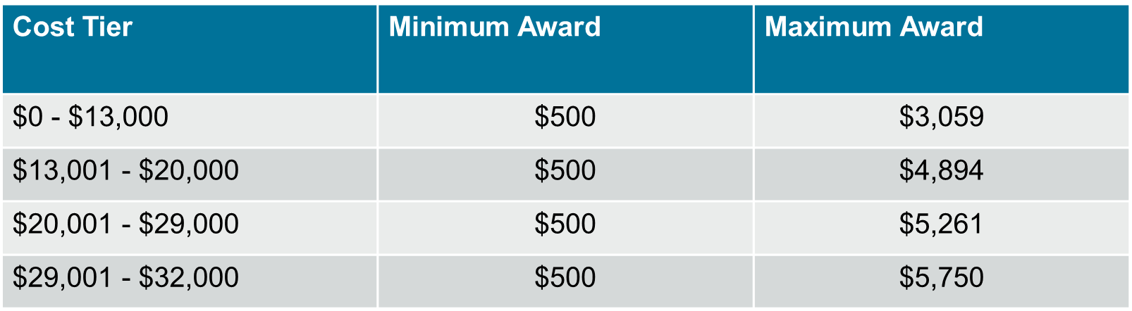
Pennsylvania State Aid
MUST SUBMIT FAFSA & PA STATE GRANT FORMS
PA State Grant: 2024-25 max award $5,750
Awarded to eligible PA residents who demonstrate financial need
Required: approved school/ approved program of study
Out of State schools in DE, MA, OH, WV, VT & DC: max $600
  Veterans: up to $800
*Max award amounts reviewed annually

Slide 11
PA State Administered Programs
PA Active Volunteer Tuition and Loan Assistance (Active Volunteer) Program – New!!
PA Blind or Deaf Higher Education Beneficiary Grant
Chafee Education and Training Grant Program– co-administered with the PA Department of Human Services
PA Fostering Independence Tuition Waiver Program (FosterEd)
PA Mental Health Education Learning Program in Schools (PA HELPS) - NEW!!
Military College Educational Assistance Program – New!!
PA National Guard Educational Assistance Grant (EAP)
PA National Guard Military Family Education Program (MFEP)
PA Postsecondary Educational Gratuity Program (PEGP)
PA Partnerships for Access to Higher Education (PATH)
PA State Work-Study - job related to major
PA Student Loan Relief for Nurses (SLRN) Program
PA Targeted Industry Program (PA –TIP)
PA Ready to Succeed Scholarship (RTSS)
Student Teacher Support Program – NEW!!

Slide 12

Work-Study
Student must have financial need to qualify for work-study
A work-study position is not guaranteed and may even require an interview
Not offered at all schools
Make sure you can balance your school and work schedules

Slide 13

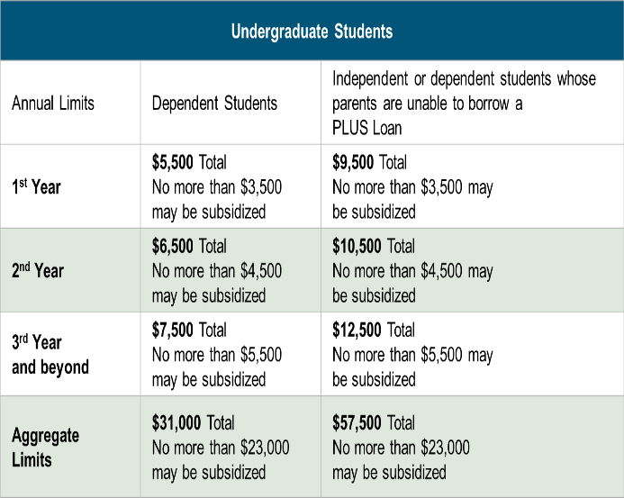
Federal Direct Loans
Loan is in student’s name
Max. borrowing limits
May receive a Direct Subsidized and/or Direct Unsubsidized loan
Fixed rate: set July 1st for 1st time borrowers
Origination fee
Deferred payments
Must complete the FAFSA®
Must complete entrance counseling & MPN

Slide 14

Additional Student Loans
Federal PLUS Loans
Private Loans
Loan is in the parent’s name
Must meet credit requirements
  May apply with a credit worthy cosigner
  If denied, student may borrow additional unsubsidized amount
May borrower up to the COA minus any other aid
Fixed interest rate: set July 1 for 1st time borrowers
Origination fee
Payments may be deferred
Student must complete the FAFSA®
Borrower = student or someone else who meets the requirements (cosigner is generally required for student borrowers)
Student or Cosigner must meet income & credit requirements
May borrower up to the COA minus any other aid
Variable or fixed interest rate
May have cosigner release clauses
Terms vary by lender
  Do your research
  Read the fine print

Slide 15

PA’s Low-Cost Way
to Pay for College!
Low, Fixed Rates
4.49 – 10.06%
1,2
^{APR}
Effective as of 05/10/24
Learn more at pheaa.org/PAForward
1) Annual Percentage Rate (APR) Calculations – The lowest APR is based on the following assumptions: a loan of $10,000 made in a single disbursement, a borrower who selected an Immediate Repayment Plan and a repayment term of 60 months, monthly payments of $186.52 and a final payment $178.29, a fixed periodic interest rate of 4.77%, and total payments of $11,183.03. The borrower in this sample qualified for a 0.25% Direct Debit benefit for the entirety of the repayment period and a 0.50% Graduation benefit was applied 47 months into repayment. The highest APR is based on the following assumptions: a loan of $10,000 made in a single disbursement, a borrower who selected an Interest Only Repayment Plan and a repayment term of 180 months, monthly payments of $108.07, a fixed periodic interest rate of 10.1%, and total payments of $23,829.83. The borrower received an in-school deferment of 46 months and a grace period of 6 months. The borrower in this sample did not qualify for any interest rate discounts. These APRs are estimates and may differ from the actual rates received.
2) The provided rate range includes Undergraduate, Graduate, and Parent loans and may change based on loan type, loan term, repayment plan, and applicable discounts (not all discounts apply to all loan products). See individual loan programs for more specific information. PHEAA uses applicant credit scores to determine eligibility and interest rates. Higher credit scores may mean an applicant is offered a lower interest rate.
Applicants, including co-signers, are subject to credit qualifications, completion of an application and credit agreement, and verification of application information.
PHEAA reserves the right to discontinue all programs or benefits without prior notice.

Slide 16

Be a Smart Borrower
Exhaust all free financial aid options before borrowing student loans
Seek federal student loans before private student loans
Only borrower the amount needed (loans must be repaid)
Do your research!
MySmartBorrowing.org: An interactive, online tool created by PHEAA that helps students and families:
  Estimate career, salaries & college tuition
  View the impact of savings on overall cost
  Calculate loan repayment
  Avoid borrowing too much money
Select a
Career
Factor in Savings
Select a School
Get Results

Slide 17
The Application Process

Slide 18

Financial Aid Forms
Know which forms are required by each school
All Schools Require:
Free Application for Federal Student Aid (FAFSA)
    Required by PHEAA, and some scholarship organizations as well
PA State Grant Forms
    Required for first -year students
    PA State Grant application process - www.pheaa.org
Some Schools Require:
CSS Profile (College Scholarship Service)
  https://student.collegeboard.org/css-financial-aid-profile
Institutional Financial Aid Forms
  Internal forms specific to each school
  Required by some schools

Slide 19
Know Your Deadlines
Admission applications
Scholarship applications
Federal, State & school deadlines exist
PA State Grant Deadlines for FAFSA®
  May 1, 2025 – First-time and renewal students attending colleges, universities & college transferrable programs (excluding community colleges)
  August 1, 2025 – First-time students attending community college; a business, trade or technical schools, hospital school of nursing; Open Admissions Institutions or a 2-year non-transferrable degree program at a Jr or 4-year college.
File the FAFSA® by the earliest deadline

Slide 20
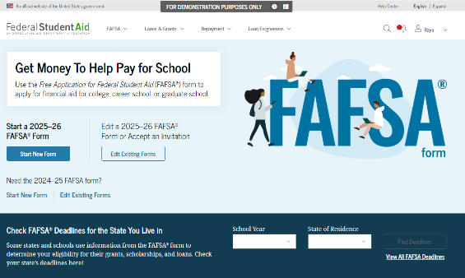
Free Application for Federal Student Aid (FAFSA®)
FAFSA® - primary form used to determine financial aid eligibility for:
  Federal & State Aid
  School Aid
  Some scholarship programs
  File annually (beginning Sr. year in high school)
Student & required contributors (parents) must:
  Provide consent for FSA to retrieve & disclose federal tax information
  Log in with their own FSA IDs to complete their respective sections & sign form
2025-26 FAFSA^{® -} Available by December 2024
Estimate federal aid: Studentaid.gov/aid-estimator
File online at studentaid.gov
or FAFSA.gov

Slide 21
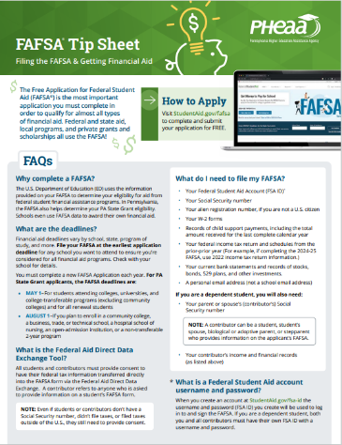

Information Needed for 2025-26 FAFSA®
Social Security Numbers
Email Addresses
(high school email address not recommended)
2023 Federal Tax Returns
Current bank statements and records of other investment accounts (as of the FAFSA® filing date including farm value and value of small business)
Current Records of any stocks, bonds and other investments, including 529 for student for whom the FAFSA® is being completed
Total child support received from the most recently complete calendar year

Slide 22
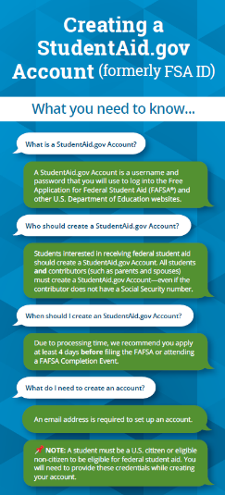
Create Your StudentAid.gov Account
The student applying for aid and all contributors providing information on the FAFSA need to create a StudentAid.gov Account at https://studentaid.gov/fsa-id/create-account.
Create at least 4 days prior to completing the FAFSA.
Legal signature for student and contributors.
Users without an SSN will be able to acquire a StudentAid.gov Account.

Slide 23
FAFSA® Steps
Personal Circumstances
Demographics
Financials
Colleges
Invite Parent Contributor
Signature
Student Section Complete Confirmation
Key sections on the 25-26 FAFSA®
Onboarding steps, wizards and help tools to guide students & contributors
Student completes all sections
Student invites required contributors
Contributors (parents) complete (demographics, financials & signature)
Form is not complete until all required signatures are submitted

Slide 24
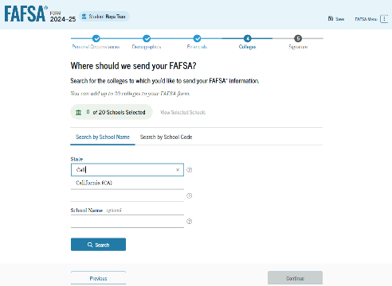
FAFSA® – Colleges Section
Colleges Section:
  Only schools listed will receive results of FAFSA®
  Don’t have to have applied/been accepted to list school
  Can list up to 20 schools at a time
  May go back and add schools later
NOTE: Once your Final Decision is made, Update your PA Grant Information with the school you WILL attend.

Slide 25
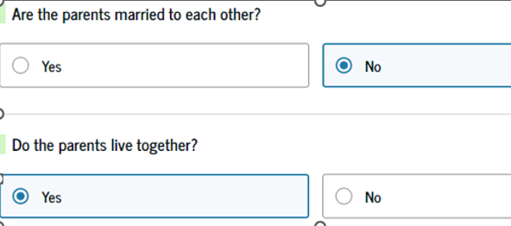
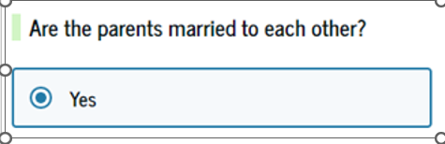

Dependent Students- Who Reports Info on the 2025-26 FAFSA®?
On the FAFSA®, the “parent” is the student’s legal (biological or adoptive) parent.
OR

Slide 26
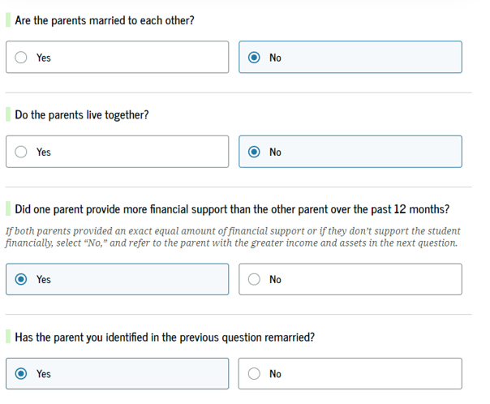
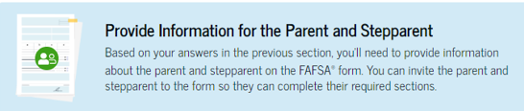
Dependent Students- Who Reports Info on the 2025-26 FAFSA®?
OR

Slide 27
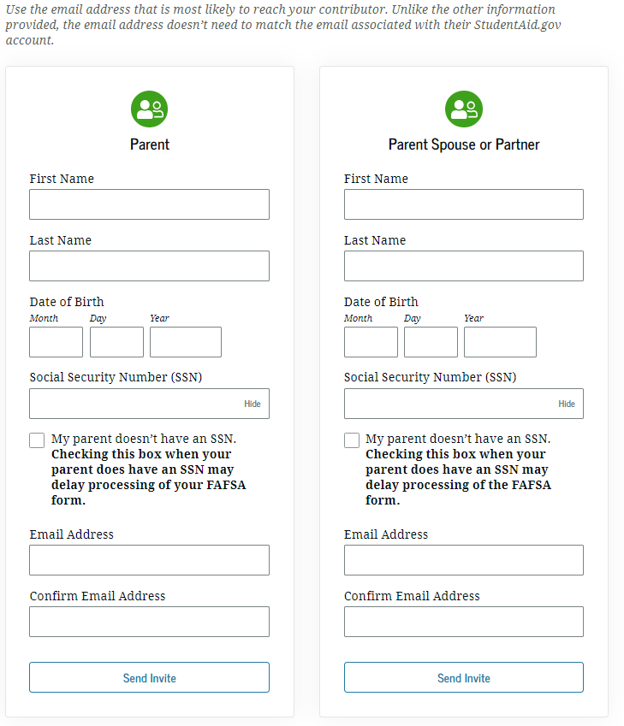
Dependent Students- Who Reports Info on the 2025-26 FAFSA®?
Answers on FAFSA® determine which contributors will be required to provide information
Student invites contributor(s) to complete their portion of the form
  Required: Name, date of birth, SSN and email address
  If parent doesn’t have SSN, check box
Contributors are not financially responsible for student’s education costs
No one else will ever provide information on the FAFSA® form for a dependent student

Slide 28

Who Is Independent?
Born before January 1, 2002
Married (and not separated)
Veteran (includes active-duty personnel)
Working on graduate level degree
Parent’s information is not required
Emancipated minor
Legal guardianship
Anytime since the age of 13 has been either:
  An orphan,
  In foster care
  Ward of the court
Have legal dependents other than spouse
Student unaccompanied and homeless or self-supporting and at risk of being homeless

Slide 29

Financial Information:
Student Aid Guide- p. 18
Assets: Some will not be required to report assets
If required to report assets:
Do not report the value of:
  Primary home
  Qualified retirement funds
  Life insurance policies
Report the net value of assets, as of the day you are completing the FAFSA®.
  Balance of checking & savings accounts, records of stocks, bonds, bitcoins, etc.
  Value of 529 accounts for the student owned by the parent(s) of a dependent applicant or owned by the student applicant
  Child support received for the most recently completed calendar year
  Net Worth of your businesses or
  For-profit agricultural operations (subtract the value of primary home if it is on the farm)

Slide 30
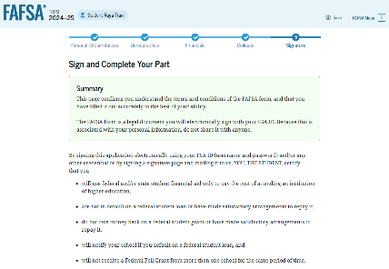
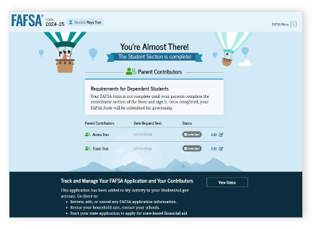
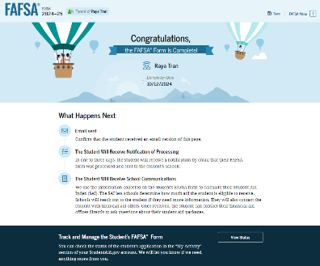
Signing with the FSA ID
FAFSA® must be signed by Student & all required contributors before it is considered complete.
If parent submits the FAFSA®, then student will receive an email and can access the detailed confirmation page.
If Student submits the FAFSA®, then they will have a different view of the confirmation page than the parent.

Slide 31

Special and Unusual Circumstances
Special Circumstances
Unusual Circumstances
If financial situation changes...
Loss of employment or financial assets
Reduced income
Tuition expenses at a secondary school
Unusual medical or dental expenses not covered by insurance
-Contact schools listed on FAFSA®
-Contact PHEAA for the PA State grant
If student is unable to provide parent information due to unusual circumstances:
Human trafficking
Legally granted refugee or asylum status
Parental abandonment or estrangement
Student or parental incarceration
- Follow Provisional Independent Status on FAFSA® form

Slide 32
Forms are Filed
What’s Next?

Slide 33
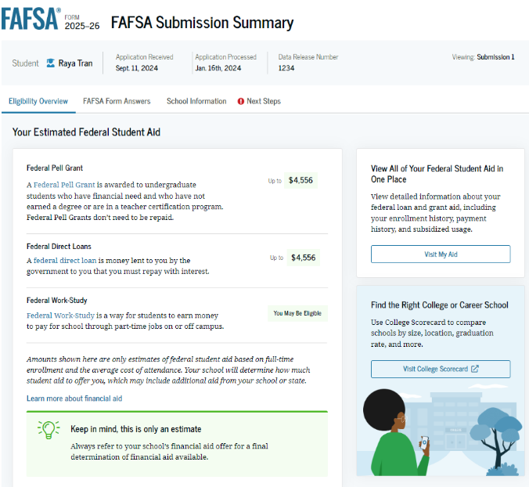
FAFSA Submission Summary
After the FAFSA® is filed:
Student receives FAFSA® Submission Summary
Review for errors, make corrections if necessary
Student Aid Index (SAI) is included on the FAFSA® Submission Summary

Slide 34

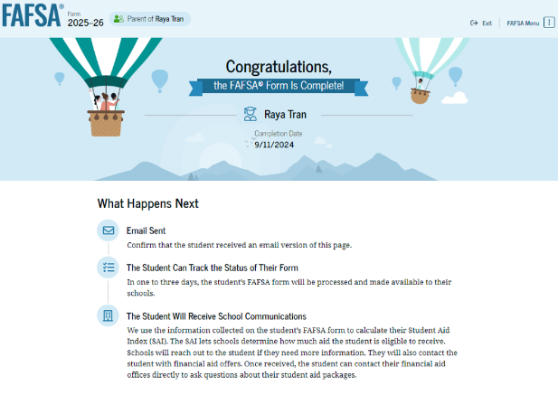
The Process Continues
After the FAFSA® is filed:
Results shared with PHEAA & schools listed on FAFSA®
Monitor emails & respond to requests from Federal Student Aid, PHEAA & schools.

Slide 35
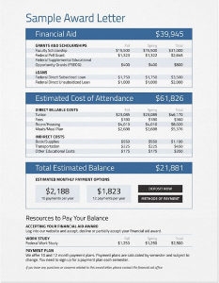
Review Financial Aid Notices Carefully
Notices vary amongst schools
Presented by the school(s) and typically includes:
  Types and amounts of aid
  Source of aid (federal, state or school)
  Student’s rights and responsibilities & academic requirements
  Explains what must be done to accept or reject aid
Contact the school’s financial aid office with questions
Bottom Line: What are your out-of-pocket costs?

Slide 36
Compare & Understand Financial Aid Offers
Do you understand your actual costs?
Do you have other children’s education costs to consider?
Have you made an affordable choice of school?
Students and parents should talk about what they can afford to pay.
Do you understand your aid offers?
How much of the financial aid is free money?
Which awards are based on need, and which are based on merit?
Are there any conditions on the free money? GPA requirement?
Will awards increase as tuition increases?
Will awards change from year to year?
Will loans be needed?

Slide 37
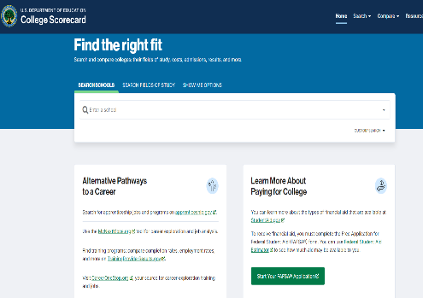
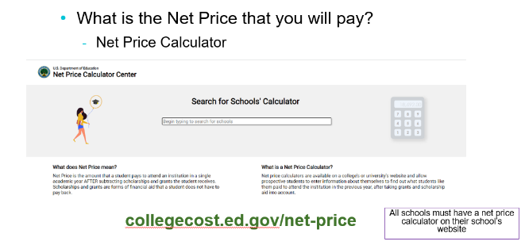
School Choice collegecost.ed.gov
Choose the school that best meets your needs
Location
Size
Job Placement
Graduation Rate
Student Life
Financial Fit
Major/academic program
Safety
Acceptance of transfer credits/AP classes
8

Slide 38
What Can You Do Now?
Research & visit schools/Websites
Continue to Explore Scholarships
Estimate Federal Student Aid
studentaid.gov/aid-estimator
Utilize Net Price Calculators
collegecost.ed.gov
Explore Scholarships
Create FSA ID & Complete the FAFSA®
Talk About What is Affordable

Slide 39

Schuylkill County
Virtual Financial Aid Night Presentation
Join Tiffanie DeVan, for a virtual Financial Aid Night presentation.
This presentation provides an early understanding of the financial aid process. Participants will gain an understanding of the types and sources of aid available to help cover the cost of attendance at post-secondary schools. Participants will also learn how to apply for financial aid, including the Free Application for Federal Student Aid (FAFSA®), which is required to determine eligibility for most student aid programs, such as the Pennsylvania State Grant, Federal Pell Grant, institutional awards, and federal student and parent loans.
Special guest, Amanda Campbell from the Schuylkill Area Community Foundation. Amanda will share information about scholarship opportunities specific to students in Schuylkill County.

Slide 40
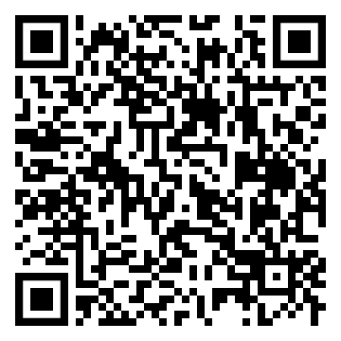
Webinar Series with PHEAA and ECYEH
Pennsylvania Higher Education Assistance Agency (PHEAA) and Education for Children and Youth Experiencing Homelessness (ECYEH) are collaborating on a webinar series regarding Pennsylvania students experiencing homelessness. Join Tiffanie DeVan from PHEAA and Elizabeth Fortuner with ECYEH as they unpack the meaning of “homelessness” and provide resources that will help students navigate life beyond high school
September 25, 2025
Diving into McKinney-Vento:
The McKinney-Vento Homeless Assistance Act plays a vital role in providing support and resources to families and students facing homelessness. This presentation breaks down this Act and how it helps to ensure students experiencing homelessness can maintain educational stability despite their challenging circumstances.
December 11, 2024
FAFSA® & Financial Aid for Students with Housing Insecurity:
Many students in foster care or those experiencing homelessness aspire to attend a postsecondary school. Obtaining the resources, support, and funding to enroll in these schools is sometimes an impossible task. This presentation provides an overview of financial aid, available resources, and explains how to navigate the Free Application for Federal Student Aid (FAFSA®) for students with special circumstances.
Scan QR code to register

Slide 41





Financial Aid Resources
Federal Student Aid Information Center
  Email, call or chat with customer service agents
  Phone: 800-433-3242 (800-4-FED AID)
  Websites: Studentaid.gov & collegecost.ed.gov
PHEAA
  Email: granthelp@pheaa.org
  Phone: 800-692.7392
  Podcast: Higher Education Access Corner
  Website: PHEAA.org
    MySmartBorrowing.org
    Educationplanner.org
    Youcandealwithit.com
  YouTube Channel: PHEAAStudentAid
Financial Aid Offices

Slide 42
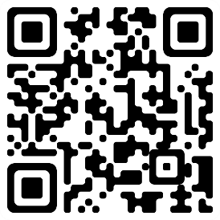
Stay Up to Date with PHEAA
Sign up for more information on our programs and services!
Would you like to learn more about funding you or your student’s higher education dreams? Sign up to get emails from PHEAA and we will send you information about loans, grants, and more!
Scan the QR to sign up!

Slide 43
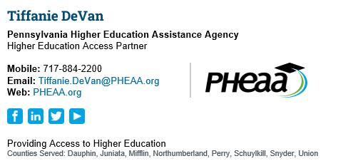
Questions?

